Slide 1



Inspire
Lorraine Rew - Industry Talent Manager CodeClan Careers Team
www.codeclan.com

Slide 2




Previous Role:
Senior Talent Acquisition Executive - Skyscanner
March 2012 till April 2018
Glasgow, UK
www.linkedin.com/in/lorrainerew
Feel free to connect with me!

Slide 3

Why did you come to CodeClan?
Discuss & Reflect
Notes:
We want to inspire the students to rethink why they came to CodeClan and to figure out their ‘WHY’ as people. How to brand themselves for interviews and think about what kind of company they are looking for and the flexibility they have when looking for a new career. Getting them to think about their CV Personal Statement

Slide 4

Career Motivations
Make a note of 3-5 things that inspired you to come to CodeClan.
What motivates you to start a career in tech / data?
What are your intentions, goals or drivers?
What are your areas of interests?
What do you want to learn more about? Is there a sector or particular industry / specialism you’d like to work in?
Everyone has soft skills and your goal should be to identify and find the best company & team culture fit for you.
Notes:
We want to inspire the students to rethink why they came to CodeClan and to figure out their ‘WHY’ as people. How to brand themselves for interviews and think about what kind of company they are looking for and the flexibility they have when looking for a new career. Getting them to think about their CV Personal Statement

Slide 5

The Importance of Soft Skills
Your personality & soft skills are incredibly valuable to employers and play a crucial part of the hiring process!
Balancing the two - and promoting yours - are important!

Slide 6
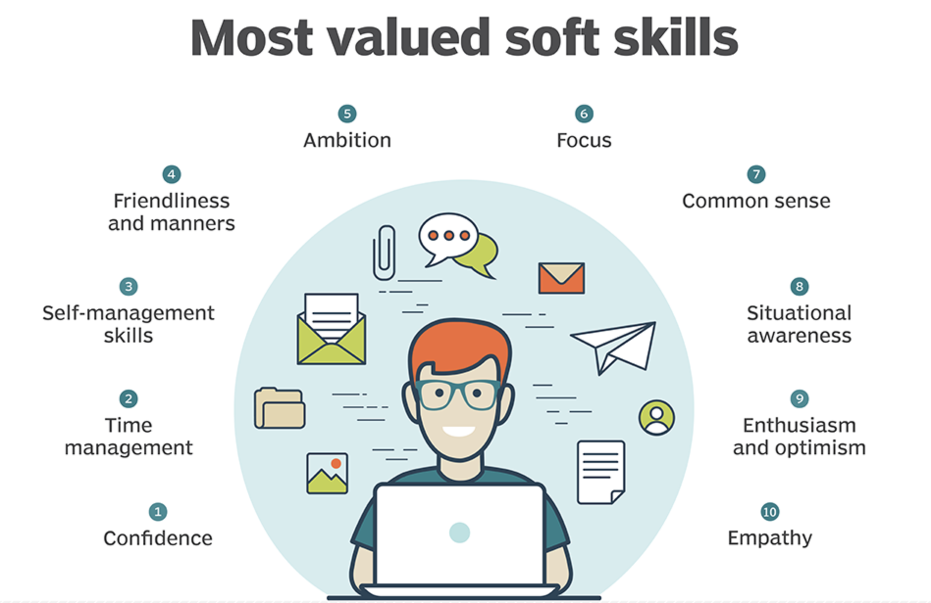
Valued soft skills for employers
creativity & attention to detail
Humility & interpersonal skills
honesty & integrity
positive attitude & personality
ability to grasp the bigger picture (business/product perspective)
Self-motivation & drive
common sense & maturity
decision making
teamwork, communication & collaboration
Self-sufficient learning

Slide 7


Demonstrate your skills & strengths
It’s important to be able to talk about yourself:
your background - - employers care about this!
your motivations & goals
your technical interests
why you want to be a software developer
your ability to be an independent learner
your contribution to a team

Slide 8

Storytelling: how would you describe yourself?
Make a list of your soft skills and previous experience and how they can add value to a business or team (aim for 10).
Think about 2-3 sentences that summarise you and tie in with the words you wrote from your list
(think about your CV opening statement)
your background - - employers care about this!
your motivations & goals
your technical interests
why you want to be a software developer
your ability to be a self learner
your contribution to a team
Notes:
Get them to write these sentences and keep them to themselves. This can be used as part of their personal statement for their CV or for LinkedIn. Ask if anyone is comfortable in sharing what they’ve wrote. Encourage them to be proud of who they are and what they think – there is no wrong or right answer.

Slide 9

What do you want from an employer?
Notes:
What is important when looking for a job? Do you want it to be 5mins down the road? Do you want to work for a company that offers training & development? Benefits? Corporate or start-up?
MAP out the differences between what a start-up vs SME vs corporate company can offer a person.

Slide 10

What do you want from an Employer?
It’s really important to know what motivates you...
… success looks different for everyone!
Make a note of your employer wish list - your top 5.
What’s most important to you right now?
What does a good job offer look like for you?
Examples:
Company culture
Tech stack, variety of technologies, innovation
How the use data / data business vs non data
Product, Software, Customers, Service Offering
Company size - start up/scale up / SME / corporate
People - technical excellence
Learning, Development & Mentoring
Salary / Benefits
Location
Notes:
What is important when looking for a job? Do you want it to be 5mins down the road? Do you want to work for a company that offers training & development? Benefits? Corporate or start-up?
MAP out the differences between what a start-up vs SME vs corporate company can offer a person.

Slide 11
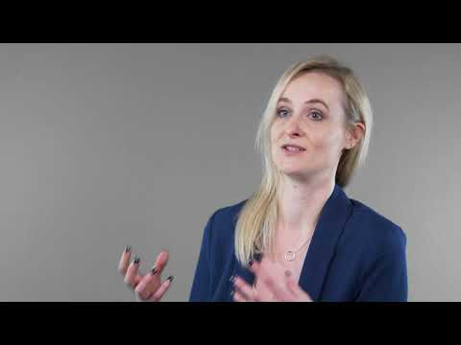
8 Secrets of Success
Meet Kirsty Software Developer & CodeClan Graduate,
Cohort G7

Slide 12

www.codeclan.com

